Slide 1
Fletcher Investigation
Team
Sept 21, 2020

Slide 2
Team
Jerry Duncan - Project Manager / Data Engineer
Everett Rush - Data Scientist
Daniel Schultz - Presentation Slides
Quan Zhou - Data Scientist
All - Reporting

Slide 3
Fletcher Books
The Middle of Things - 272 Pages
Scarhaven Keep - 216 Pages
The Talleyrand Maxim -182 Pages
The Middle Temple Murder - 256 Pages
Dead Men’s Money - 289 Pages

Slide 4
Methods
Import each novel from URL (Beautiful Soap)
Split sentences for each book using regular expressions (RE)
NLTK for tokenization: Chapters -> Sentences
Custom REGEX formula for processing
Extract data into JSON format
Graph Relevant results using PyPlot

Slide 5
Results
Goal: Answer some key questions.
When does the detective (or a pair) occur for the first time?
When is the crime first mentioned - the type of the crime and the details?
When is the perpetrator first mentioned?
What are the 3 words that occur around the perpetrator on each mention?
When and how the detective/detectives and the perpetrators co-occur?
When are other suspects first introduced?

Slide 6
The Middle of Things
When does the detective (or a pair) occur for the first time?
Detective Viner: Chapter 1 Sentence 1
When is the crime first mentioned - the type of the crime and the details?
Murder: Chapter 1 Sentence 76
When is the perpetrator first mentioned?
Cortelyon: Chapter 2 Sentence 54
What are the 3 words that occur around the perpetrator on each mention?
90 context words
When and how the detective/detectives and the perpetrators co-occur?
Detective-perp Co-occurrences [(3, 78), (28, 134)]
When are other suspects first introduced?
Penkridge: Chapter 1 Sentence 1

Slide 7
Scarhaven Keep
When does the detective (or a pair) occur for the first time?
Detective Copplestone: Chapter 1 Sentence 39
When is the crime first mentioned - the type of the crime and the details?
Fraud: Chapter 15 sentence 139
When is the perpetrator first mentioned?
Peter Chatfield, Addie Chatfield: Chapter 4 Sentence 114
What are the 3 words that occur around the perpetrator on each mention?
969 context words
When and how the detective/detectives and the perpetrators co-occur?
Detective-perp Co-occurrences [(6, 3), (6, 32), (8, 161), (18, 73), (21, 47), (21, 84), (21, 98), (22, 87), (23, 45), (27, 37), (29, 110), (30, 189), (31, 1), (31, 78), (31, 160)]
When are other suspects first introduced?
Audrey Greyle: Chapter 3 Sentence 166

Slide 8
The Talleyrand Maxim
When does the detective (or a pair) occur for the first time?
Detective Linford Pratt: Chapter 1 Sentence 1
When is the crime first mentioned - the type of the crime and the details?
Murder: Chapter 7 Sentence 93
When is the perpetrator first mentioned?
Harper Mallathorpe: Chapter 1 Sentence 57
What are the 3 words that occur around the perpetrator on each mention?
635 context words
When and how the detective/detectives and the perpetrators co-occur?
Detective-perp Co-occurrences [(2, 130), (2, 147), (2, 148), (2, 149), (2, 150), (5, 1), (5, 18), (5, 21), (5, 26), (5, 27), (5, 30), (5, 114), (5, 117), (5, 158), (5, 171), (5, 193), (6, 121), (7, 122), (8, 1), (8, 11), (8, 21), (8, 24), (8, 35), (8, 50), (8, 97), (8, 165), (10, 90), (10, 164), (10, 182), (11, 40), (11, 74), (12, 168), (12, 179), (12, 217), (12, 219), (12, 253), (12, 270), (12, 278), (12, 291), (12, 299), (12, 300), (12, 315), (13, 32), (13, 34), (13, 68), (13, 85), (13, 93), (13, 106), (13, 114), (13, 115), (13, 130), (14, 46), (14, 154), (15, 129), (16, 113), (16, 138), (16, 156), (16, 173), (16, 178), (17, 51), (17, 56), (17, 67), (18, 148), (18, 150), (21, 10), (21, 13), (21, 70), (21, 125), (21, 154), (22, 1), (25, 34), (25, 40), (27, 48), (27, 50), (27, 63)]
When are other suspects first introduced?
Nesta: first Chapter 2 Sentence 17

Slide 9
The Middle Temple Murder
When does the detective (or a pair) occur for the first time?
Detective Frank Spargo: Chapter 1 Sentence 1
When is the crime first mentioned - the type of the crime and the details?
Murder: Chapter 1 Sentence 24
When is the perpetrator first mentioned?
Jane Baylis: Chapter 19 Sentence 24
What are the 3 words that occur around the perpetrator on each mention?
360 context words
When and how the detective/detectives and the perpetrators co-occur?
Detective-perp Co-occurrences [(19, 41), (21, 153), (23, 11), (23, 13), (23, 34), (23, 35), (24, 1), (24, 22), (25, 17), (26, 31), (27, 6), (27, 8), (27, 17), (27, 59), (29, 71), (30, 133), (36, 131)]
When are other suspects first introduced?
Chamberlayne: Chapter 6 Sentence 156

Slide 10
Dead Men’s Money
When does the detective (or a pair) occur for the first time?
Detective Hugh Moneylaw: Chapter 1 Sentence 19
When is the crime first mentioned - the type of the crime and the details?
Murder: Chapter 1 Sentence 3
When is the perpetrator first mentioned?
Gilbert Carstairs: Chapter 7 Sentence 6
What are the 3 words that occur around the perpetrator on each mention?
676 context words
When and how the detective/detectives and the perpetrators co-occur?
Detective-perp Co-occurrences [(22, 67)]
When are other suspects first introduced?
Dead Men’s Money had no Other Suspects

Slide 11
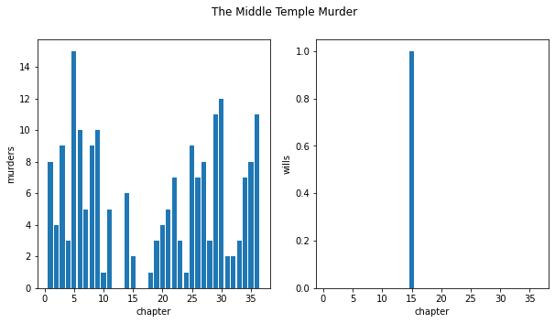
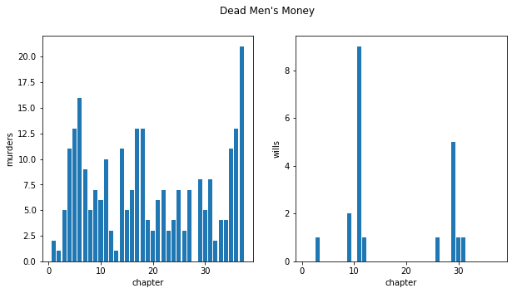
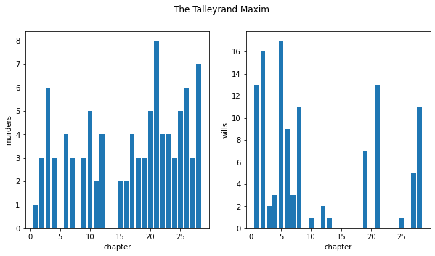
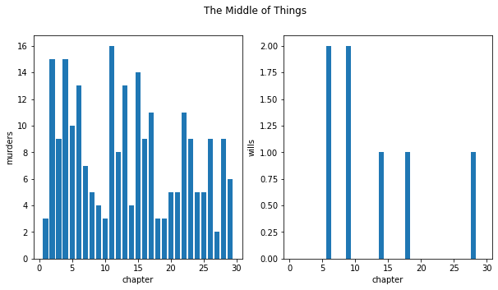
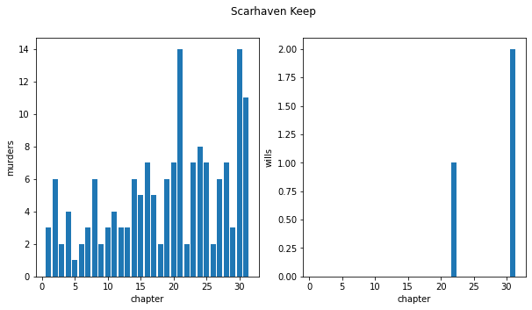
Graphs
Notes:
Briefly Summarize the relationship between murder to wills over each chapter for each book.

Slide 12
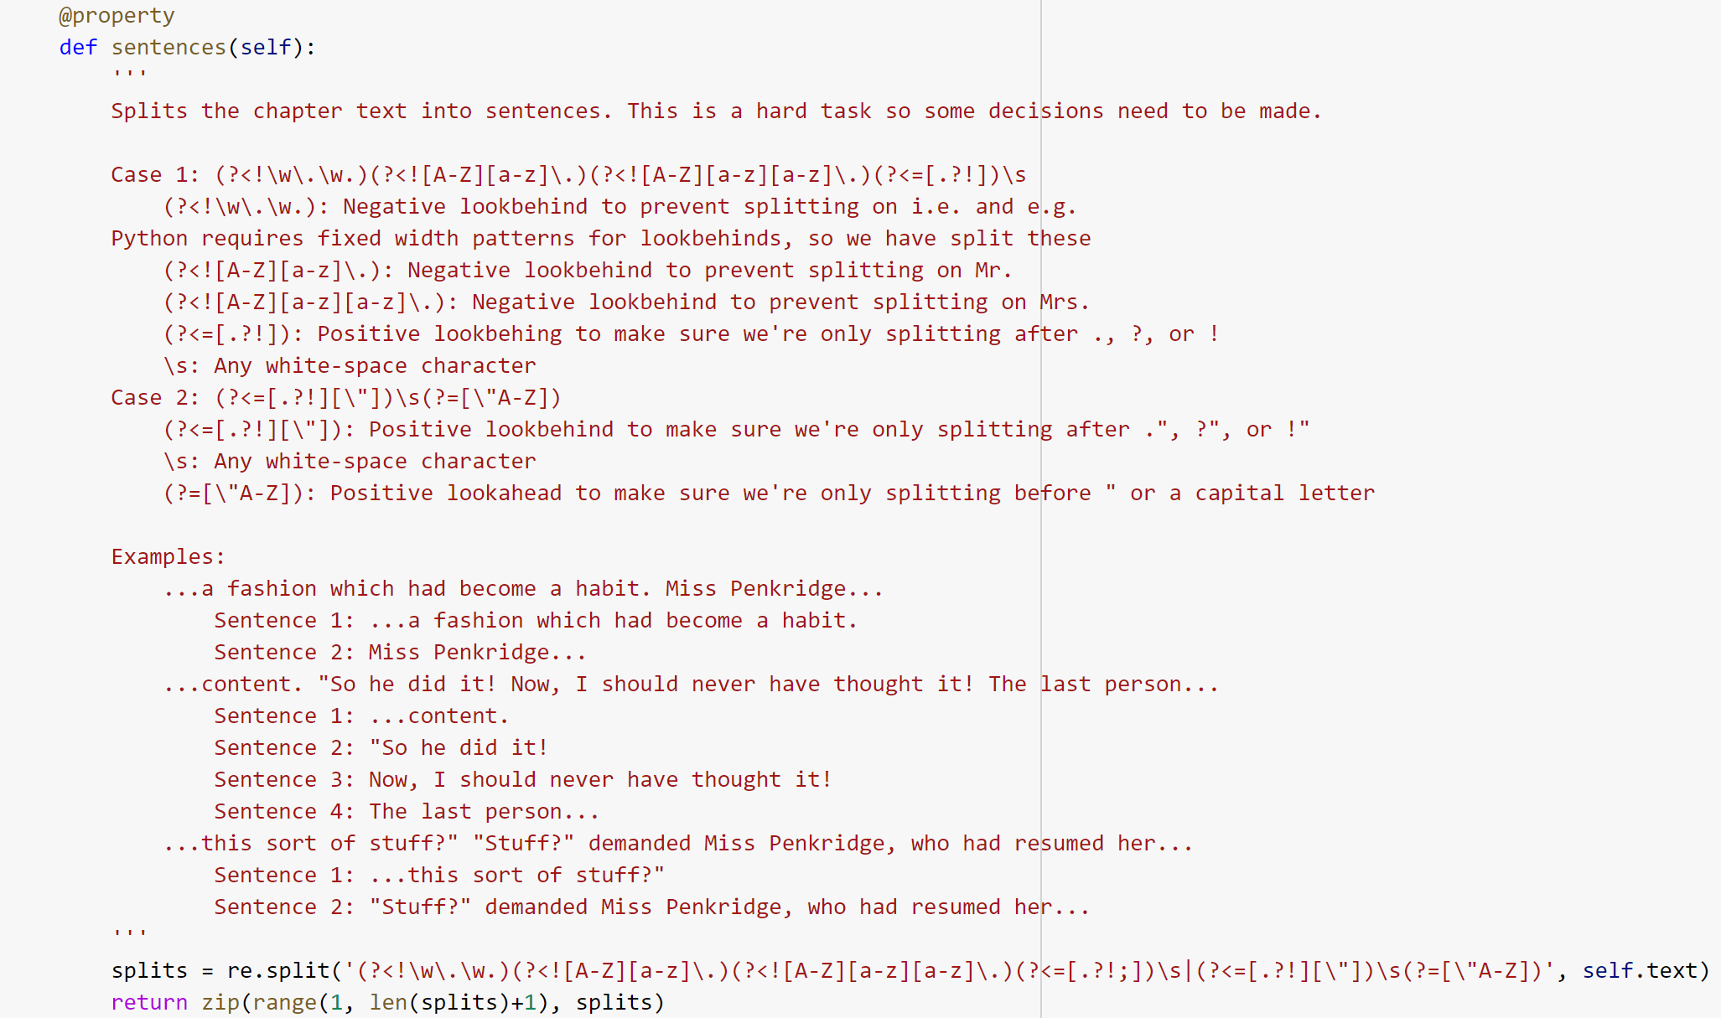
RegEx

Slide 13
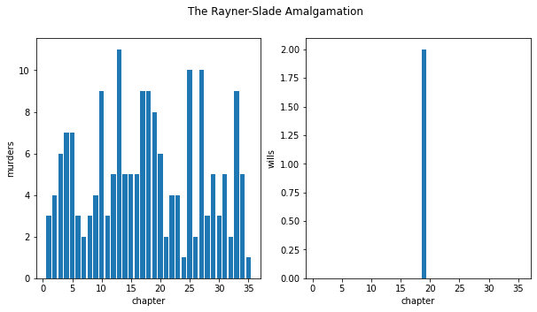
What Worked/Didn't Work
Plot complexity can be an issue.
The Rayner-Slade Amalgamation - Very complex plot & multiple personalities
Notes:
Here, we can talk about anything that didn’t seem to work in the project. Most Notedly the RSA book which had multiple personalities and as a result relationship between murders/wills mentions is much different than other books.

Slide 14
Questions

Slide 15
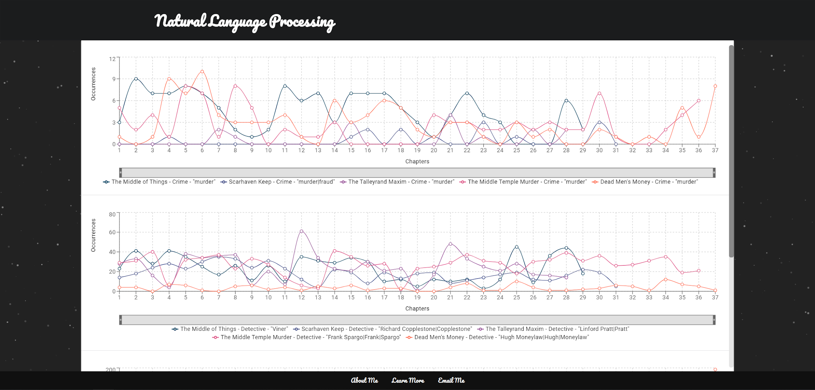
Interactive Demo - https://ece692-nlp.web.app/

